Slide 1
Basics of Tourism
PhD., Acting Associate Professor Nakhipbekova Symbat

Slide 2
LECTURE 6
Classification of Tourism
1. Functions and forms of tourism in modern conditions
2. Types of Tourism
3. Tourist routes and their types

Slide 3
Functions of Tourism
Health
Integration
Socio-economic
Social status
Development

Slide 4
Basic principles of classification | Types of Tourism
Territorial principles | World: International; Domestic Regional: Interregional; Internal regional
Principles of direction of flow | Exit; Log in. Depending on the direction of Service: Receptive (receptive); Initiative (guide )

Slide 5
Organizational principles | Due to participation in the turindustria: Organized (planned), one form packaged (pakij-tourism) Unorganized (self-contained) Depending on the number of participants: Group (5 high, now 12-14 people); Individual (individual) (1-5 people)
Financial and economic principles | By sources of financing: Commercial; Social; By relation to balance payments: Active; Inactive
Depending on the types of use of tourist resources | On the beach; The sea; The river; In the mountains; The cave

Slide 6
Depending on the types of tourist destinations | Natural; Cultural; City; Rural; Coastal
By the displacement method | Walking; Transport; Mixed. By type of transport vehicles: Aviation; Railway; Automotive; Bus; Cruise; Space
Depending on the length of the route: | Close; Far away; Adjacent adjacent; Intercontinental; EarthShare

Slide 7
Depending on the duration of the trip | Short-term;Medium term;Long-term
The principle of subjectivity | Family; School; Youth; Children; Persons of the” Third " Age Faces of the” Fourth " Age
Motivational-target principle | By the purpose of traveling: Vacation tourism Business tourism Vacation tourism: Cultural (cultural and cognitive); Visiting friends and relatives (VFR-tourism); Educational tourism; Medical and health; Sports;Spiritual and cognitive (religious) Event

Slide 8
Motivational-target principle | Adventure;Special. Business tourism:MICE-tourism Corporate; Congress; Exhibition; Intensive (encouraging); Presentation (advertising and information)

Slide 9
Tourist routes depending on the duration
One-day
Monthly
Annual
Weekly

Slide 10
Tourist routes
Linear tourist route
Round-trip tourist route
Radial tourist route
Mixed tourist route

Slide 11
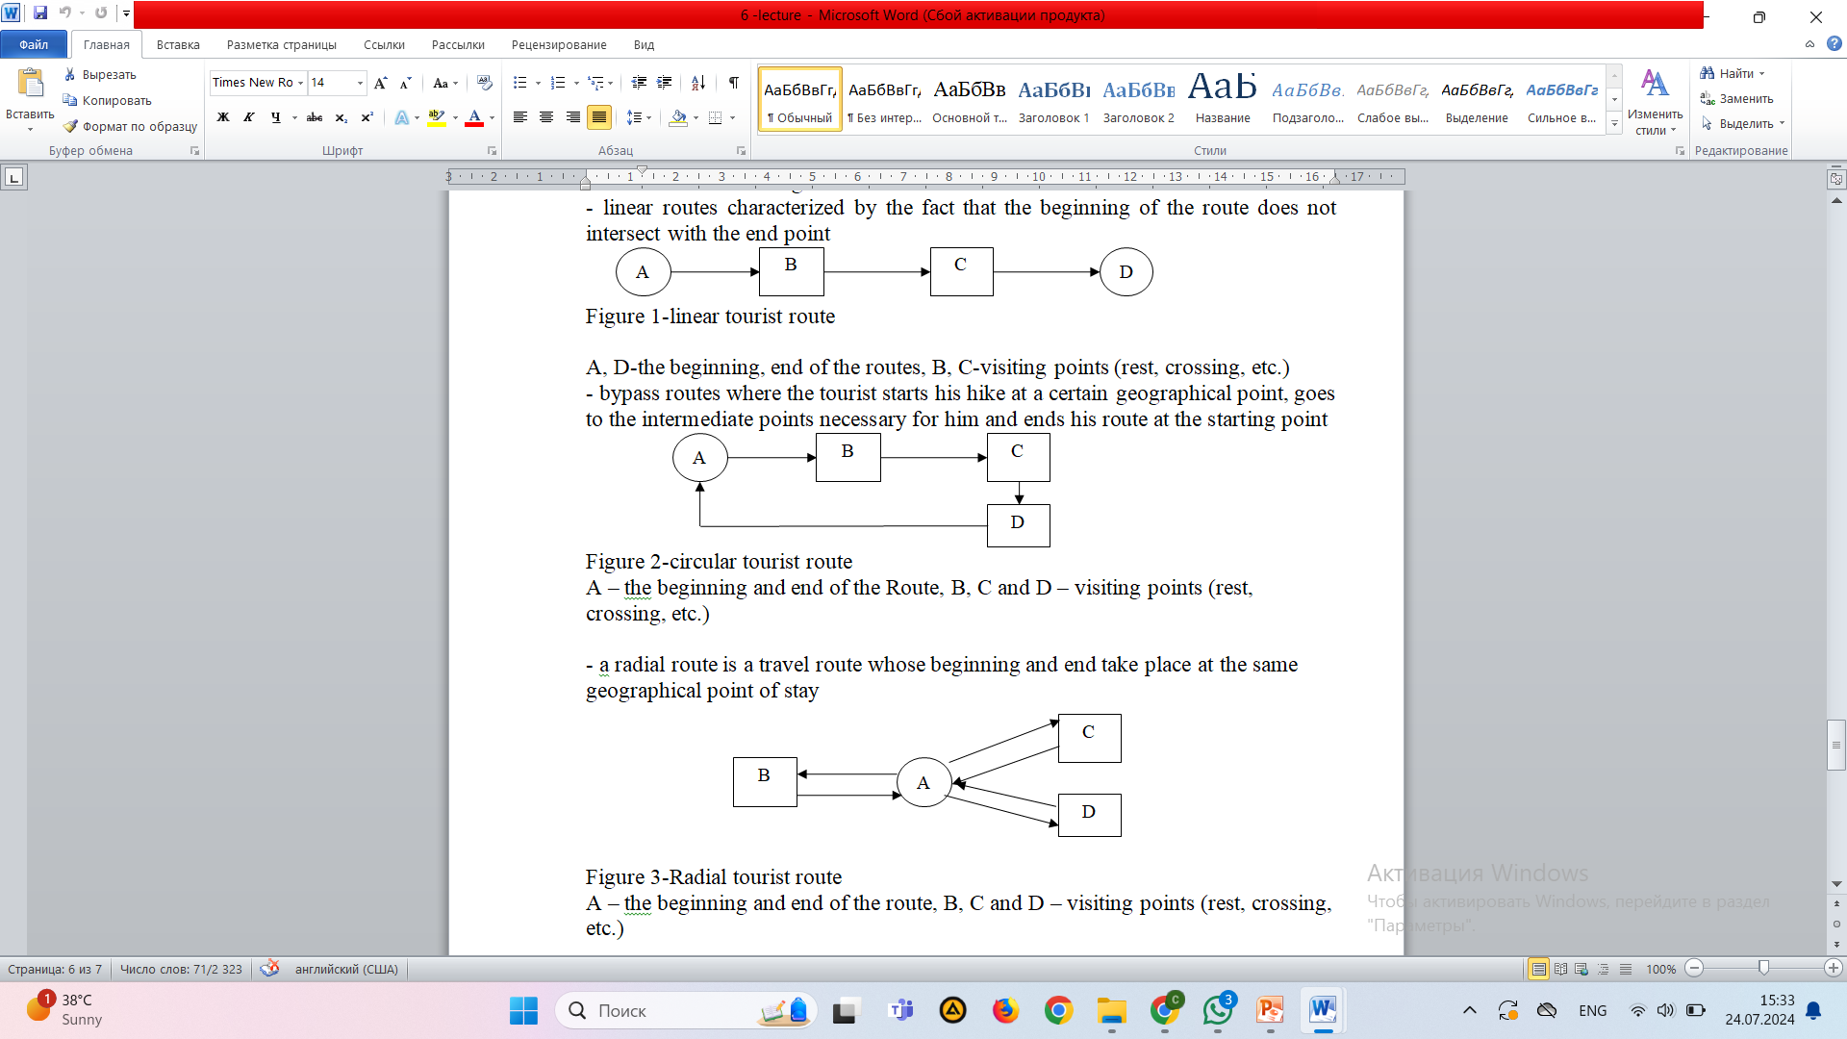

Slide 12
