Slide 1
Basics of Tourism
PhD., Acting Associate Professor Nakhipbekova Symbat

Slide 2
LECTURE 5
Impact of tourism on the natural and socio-cultural environment
1. Tourism in the context of globalization
2. The main external effects of Tourism Development
3. The Twelve sustainable tourism goals (UNWTO)

Slide 3
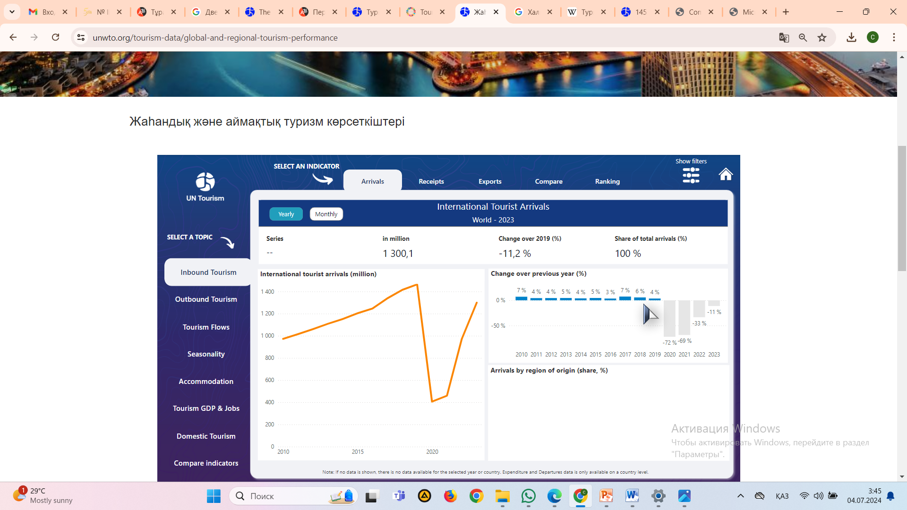
international tourist arrivals

Slide 4
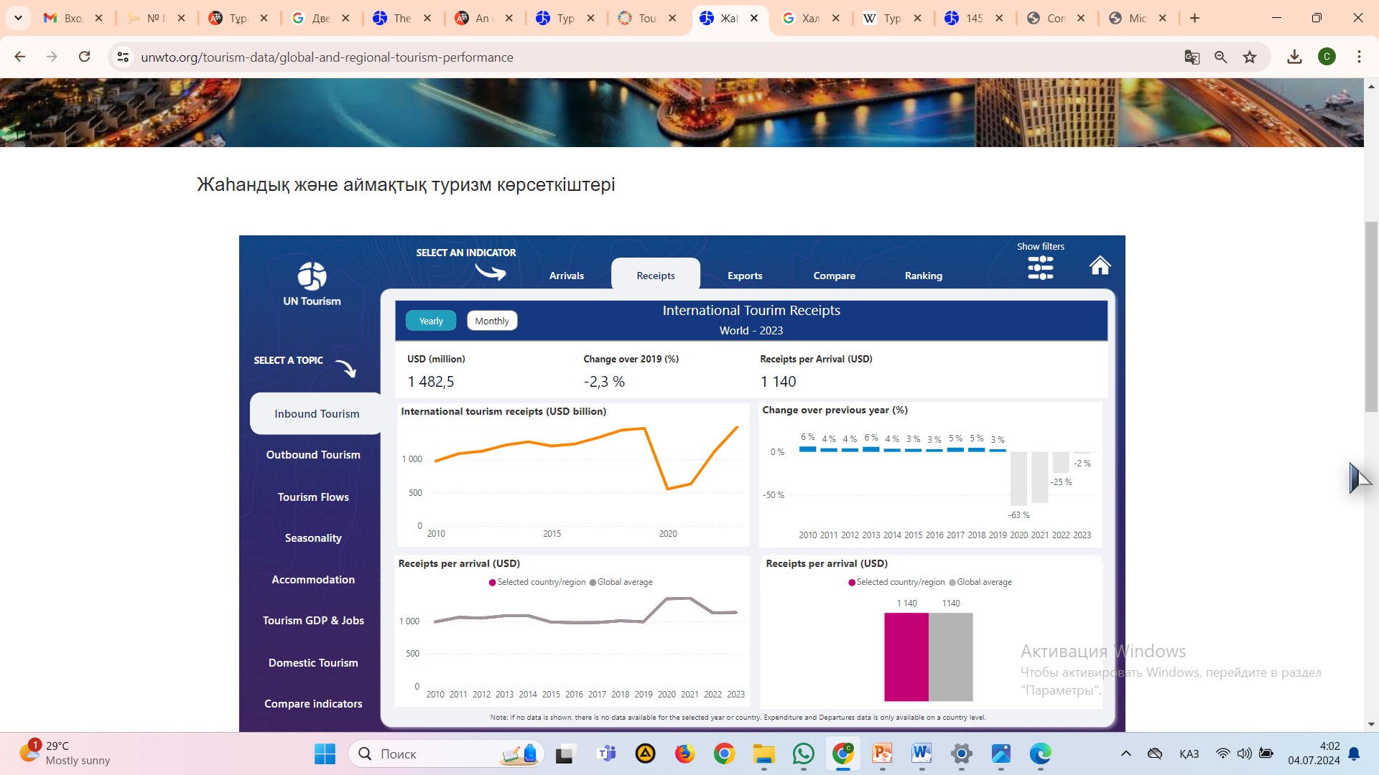
international tourism receipts

Slide 5
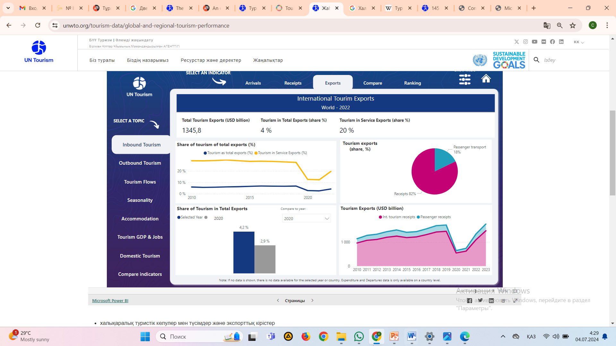
international tourism exports

Slide 6
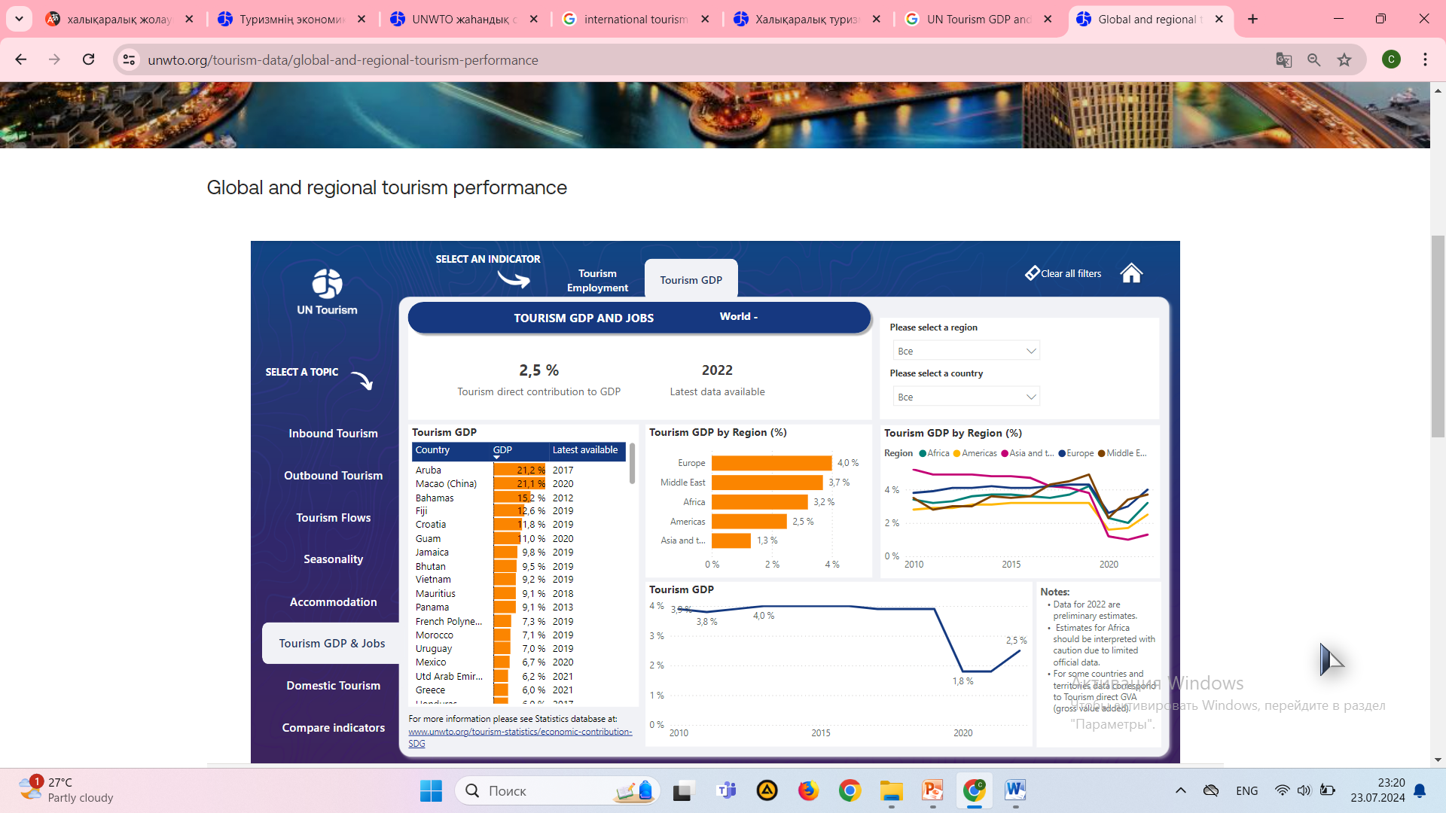
Tourism GDP

Slide 7
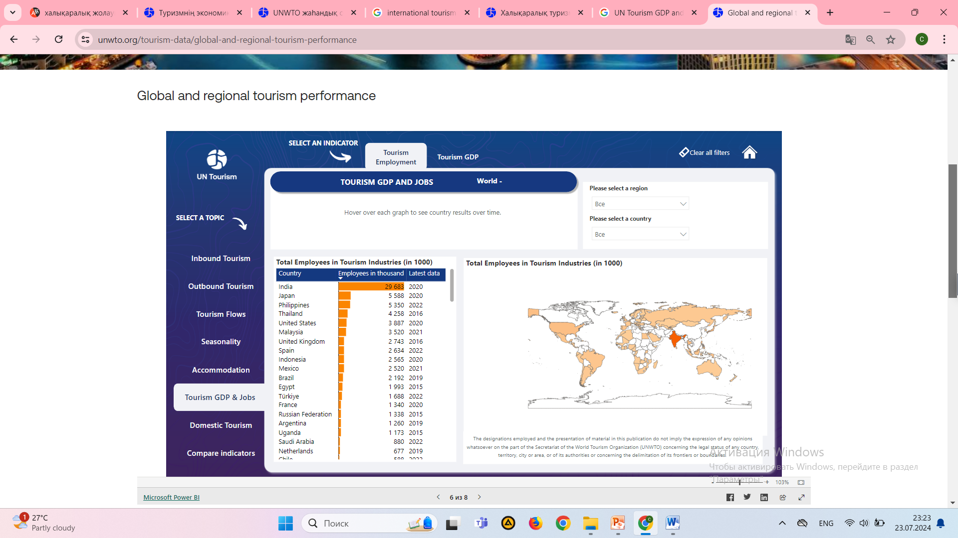
Tourism Employment

Slide 8
Sustainable development
Economic aspect
Environmental aspect
Socio-cultural aspect

Slide 9
Sustainable tourism
ensures the optimal use of Natural Resources, which are a key element in the development of tourism, supporting important environmental processes and helping to preserve natural resources and biodiversity;
shows respect for the socio-cultural characteristics of the host community, preserves their cultural heritage and traditional values, promotes intercultural understanding and tolerance;
guaranteee viable, long-term economic operations by providing and equitably distributing socio – economic benefits for all participants-sustainable employment and income opportunities, Social Security in the host communities, and thus promote poverty reduction.

Slide 10
the main reasons that stimulate the development of Tourism and recreation are
economic reasons
social reasons
environmental reasons

Slide 11
A number of negative external effects of tourism development, both for the environment and for the socio-economic sphere, can be identified:
-
disruption of natural connections in ecosystems;
loss of traditional activity, traditional economic structure, changes in local identity and values
-
unjustified increase in population density in tourist and recreational centers;
-
increased noise and vibration levels;
-
erosion of the soil and banks of water bodies;
-
intensive environmental pollution;
-
irrational (in some cases uncontrolled) use of Natural Resources;
-

Slide 12
Экологияға әсері
direct financial contributions to environmental protection, paid for visits to parks and reservoirs, fishing, etc. ;
- support and development of specially protected natural areas;
- replacement of natural and environmentally hazardous sectors of the economy in certain regions and countries with environmentally oriented tourism, including in the agricultural and environmental sectors;
- reducing the impact on nature;
- rationalization of land use;
- protection of rare species and ecosystems, etc.
Intensive consumption of water resources to ensure the direct consumption of hotels, swimming pools, tourists;
- degradation and depletion of land resources as a result of the intensive construction of residential buildings, roads, airports associated with tourism and Recreation and the use of land resources as building materials for the creation of residential infrastructure;
- increase in atmospheric pollution due to the increase in international tourist transportation by all types of transport;
- noise pollution from vehicles;
- impact on biodiversity;
- increase in energy consumption due to the construction of new tourist infrastructure facilities;
- "aesthetic pollution" due to the inconsistency of the architectural styles of resort complexes with the appearance of the surrounding natural environment

Slide 13
Impact on the socio-cultural environment
- ensuring cultural exchange between the peoples of the world, strengthening peace on Earth;
- strengthen local communities through the preservation and development of various festivals of local culture, etc. ;
- creation of public services and amenities that would not be available without the development of Tourism;
- preservation of cultural and historical traditions as attractive factors for the development of Tourism;
- mental and physical rest;
- job creation, etc.
- change in local individuality and values as a result of the commercialization of local culture;
- cultural conflicts caused by economic inequality between tourists and local residents, the behavior of tourists;
- damage to culture due to vandalism, illegal export of cultural heritage items;
- conflict related to the use of Natural Resources;
- the development of crime associated with the urbanization of territories as a result of the development of mass tourism;
- change the terms of work, lease, etc.

Slide 14
Impact on the economy
- increase in revenues to regions developing tourism (according to WTO data, tourism is the main source of foreign currency profit for 38% of all countries);
- multiplier effect on the economy;
- creation of new jobs;
- attracting investments in the development of infrastructure, etc.
- increase in costs for the development of local infrastructure at the expense of local budgets (taxpayers) ;
- increase in prices due to increased demand for basic goods and services on the part of tourists;
- economic dependence on tourism, which is characteristic of many regions where tourism is the main sector of the economy;
- economic problems associated with the seasonality of tourism in regions that are heavily dependent on the tourism industry, the growth of"off-season" unemployment.

Slide 15
Economic viability
12.Environmental friendliness
11. Resource efficiency
10.Biological Diversity
9.Physical integrity
8.Cultural wealth
7.Community Welfare
6.Local control
5.Affordable tourism
4.Social Justice
3.Quality of employment
2.Local Prosperity

Slide 16
Conclusion
Sustainable tourism involves optimal use of resources, including reducing biodiversity, environmental, cultural and social impacts, and maximizing profits to preserve local communities.

