Slide 1
Basics of Tourism
PhD., Acting Associate Professor Nakhipbekova Symbat

Slide 2
LECTURE 3
The role of recreational geography in the development of tourism activities
1 Subject and object of recreational geography
2 The connection of recreational geography with tourism activities
3. Geographical methods for assessing the tourist and recreational potential of the region
4 The concept of tourist zoning and the activities of tourist centers
5 Features of the activities of tourist centers
6 Tourist destination and its main characteristics
7 Tourist areas and zones

Slide 3
Geography began to study recreational resources, socio-economic prerequisites for tourism, the economic significance of tourism, the problems of interaction between nature and recreation.
Recreational geography was formed as a separate field of knowledge, in the early 60s of the twentieth century, and was taught as a separate subject only in 1974 in higher educational institutions of the USSR.

Slide 4
The main objectives of recreational geography
Assessment of tourist resources
Economic and geographical assessment of objects

Slide 5
The first work in the field of the study of recreational activity within the framework of geography was carried out by representatives of the Institute of geography of the USSR Academy of Sciences V. S. Preobrazhensky, A. A. Mints, I. P. Gerasimov and others.
V. S. Preobrazhensky identified the characteristics of the recreational system, which in its functional essence seemed objective and social.
N. S. Mironenko and I. T. Tverdokhlebov recreational activity "differs in geography", spatial understanding is distinguished, and is characterized by the selection of territory.

Slide 6
The relationship of recreational geography with tourist activity
Individual subject of recreational activity
Organization of recreational systems in geographic space

Slide 7
cartographic knowledge in recreational geography by d. v. nikolaenko
to be able to read maps and know the possibilities of cartography reflecting various phenomena of interest to recreational geography;
to be able to correctly draw up maps for the purposes of recreational geography, formed during the implementation of systematic training in the field of theory and practice of geography.

Slide 8
The compilation of scientific principles of tourist zoning and its further development will allow to identify new recreational resources for the development of tourism in undeveloped territories; identify and create new tourist districts of different orders; correctly determine their tourist specialization, transfer the experience of tourism development of the same districts to other districts with similar conditions; differentially look at a variety of tourist districts
A.S. Kuskov, T.N. Odintsovo, V.L. Golubtseva

Slide 9
the process of tourist zoning consists of 4 stages
1
associated with the exploration of territories with potential tourist resources, but not developed;
2
starting with the rapid economic development of the new district;
3
4
characterized by the stabilization of the tourist area and the transition to other routes.
the district has reached a high level of socio-cultural development.;

Slide 10
Types of tourist centers
Аксиологиялық туристік орталық – мәдени-тарихи мұраны, діни ағымдарды, этнографиялық, фестивальдардың және конгресстердің өткізілуімен байланысты туристердің қажеттіліктерін қанағаттандыру
Экологиялық түрдегі туристік орталықтар экологиялық туризм маршруты өтетін табиғи ландшафттар, ұлттық парктер мен қорықтар, аңшылық-балықшылық ресурстар, көзтартатын акваторийлардан тұратын табиғи құндылықтар
Рекреациялық түрдегі туристік орталықтар – санаторлы-курорттық қызмет көрсетудің негізінде сауықтыру қызметтерін ұсынатын туристік орталықардан құралады
Таулы үлгідегі туристік орталықтар – экстремалды қызмет пен таулы жерлерде белсенді демалыспен байланысты туристік қажеттіліктерге бағытталады
Сумен байланысты туристік орталықтар – су қоймаларының маңында орналасқан туристік орталықтар. Олар жағада белсенді (ойындар), белсенді емес (пляждық), суда (каноэда жүзу, серфинг және т.б.) немесе су астында (дайвинг) қызмет көрсету

Slide 11
Tourist sending area
Tourist receiving area
Tourist services market
Tourist destination
Transit zone
Tourist destination concept

Slide 12
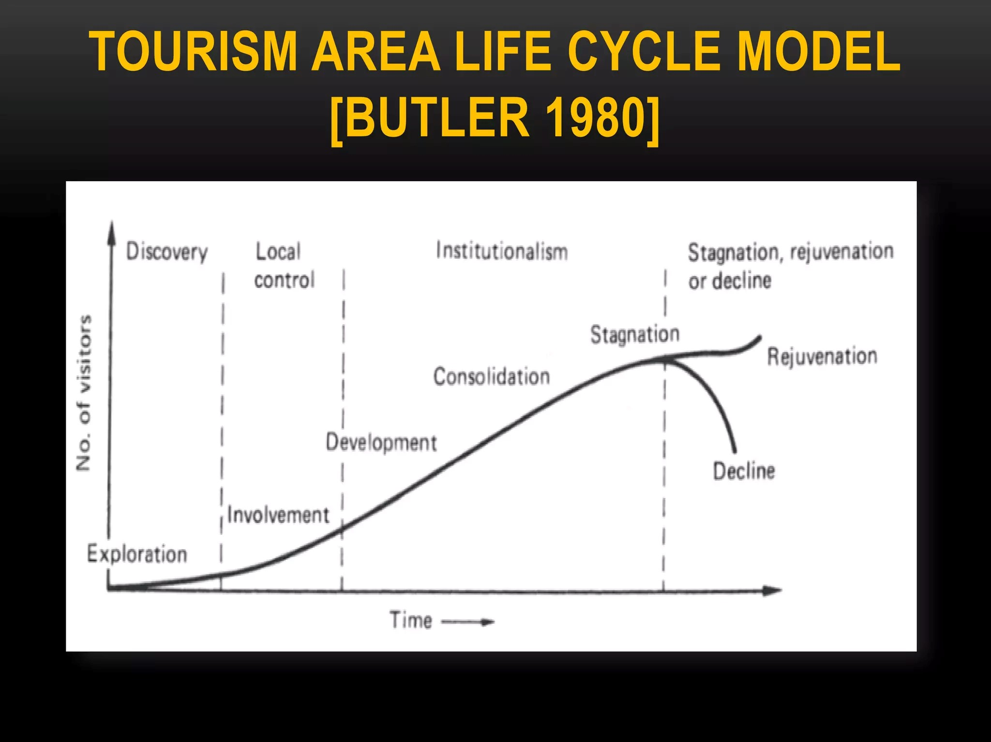
Development of tourist destinations by R. Butler
(S-shaped theory of destination formation)
Figure 1. The hypotic life cycle of R. Butler's tourist destination

Slide 13
L. Spangen is understood as a geographical territory (place, region), which has a large network of special structures and services necessary for organizing recreation, educational process or wellness.
Tourist area
It follows from the WTO definition that a tourist area includes any monuments that are selected by a tourist or a group of tourists, implemented by manufacturers of tourist services, adapted to tourist buildings and services.

Slide 14
Conclusion
That recreational geography deals with the questions of the organization and development of recreational activities in the tourism system, the main task of which is to study tourist and recreational activities, from the point of view of the characteristics of objects located in the regions.

